Slide 1
Simulation and Analysis of model for evolution of monogamy
Origin paper: The evolution of monogamy in
response to partner scarcity

Slide 2
Summary of paper
Many people claim that Monogamy is the result the parternal care(PC) because female select men who have more ability to take care of them and baby.
This is based on axiom that female have right to select partner.
But this stragy have vulnerbility to cuckload by Multiple Mating(MM).
So, Male Guarding(MG) evolue first for prohibiting access to their female by MM.

Slide 3
Simulation
I tried to change 3 variable u, k and y, which u is probability of men’s survive, k is the willingness of females to engage in extra-pair mating and y is sex ratio.
I tried to change u as 0.5 and 0.2 which is lower than 0.9 in paper.
I use k as 0.1(paper) and 0.25, which the former is related to one survey and 0.25 is related to proportion of genes.
I initialize sex ratio as not only 2/3(paper) but also 5/6, which the letter is related to Korea.
Notes:
0.9 is estimated by female survival rate during 1 years, so we change it as men’s one.

Slide 4
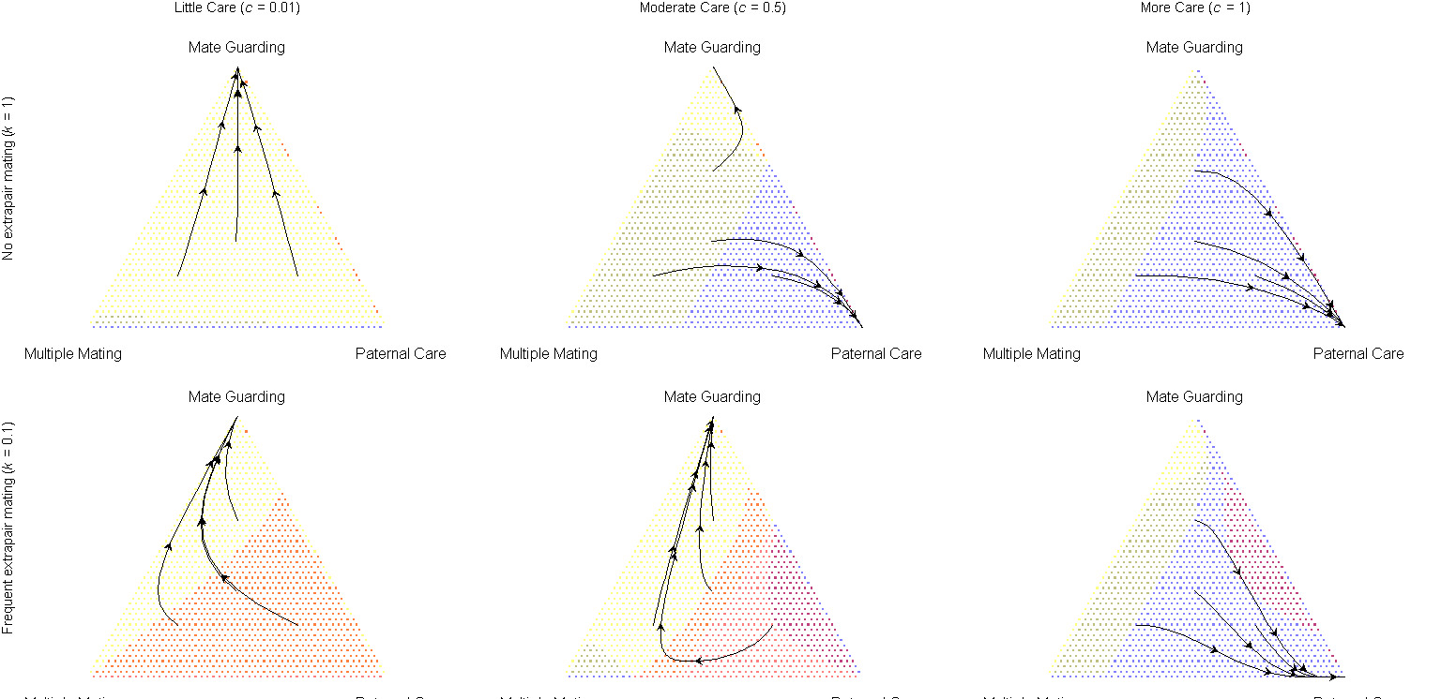
Simulation
u=0.5, k=0.1, Men’s biased(2/3)

Slide 5
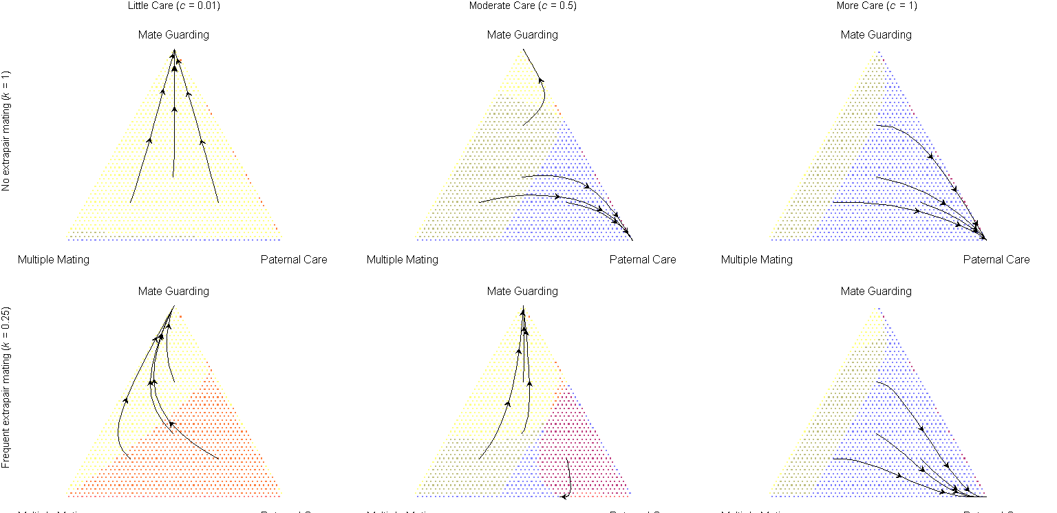
Simulation
u=0.5, k=0.25, Men’s biased(2/3)

Slide 6
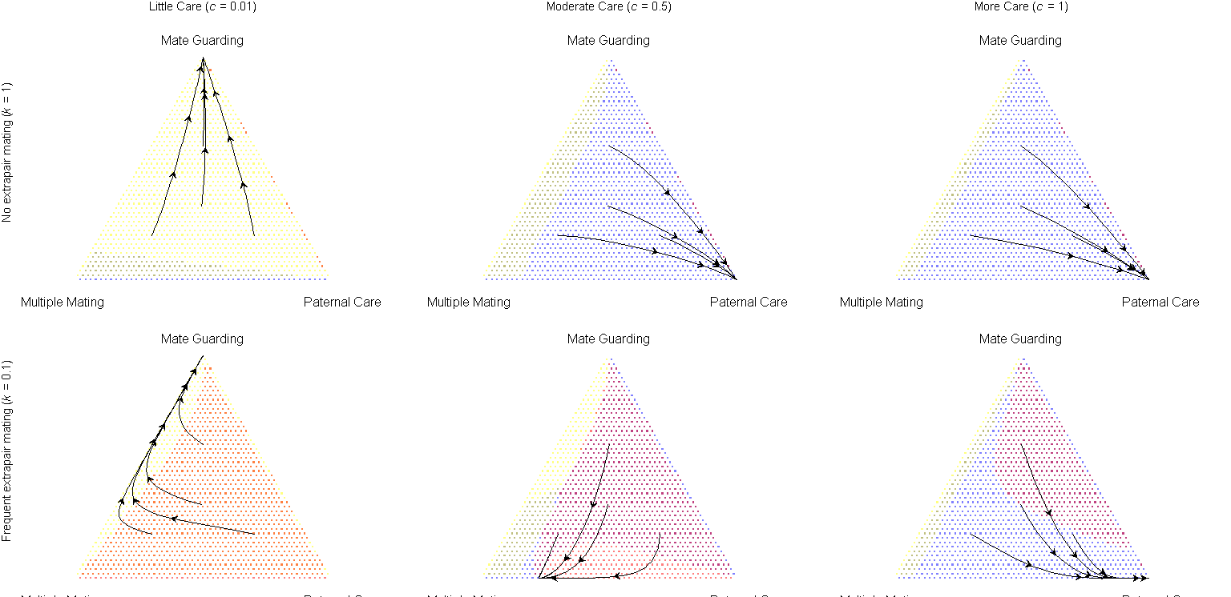
Simulation
u=0.2, k=0.1, Men’s biased(2/3)

Slide 7
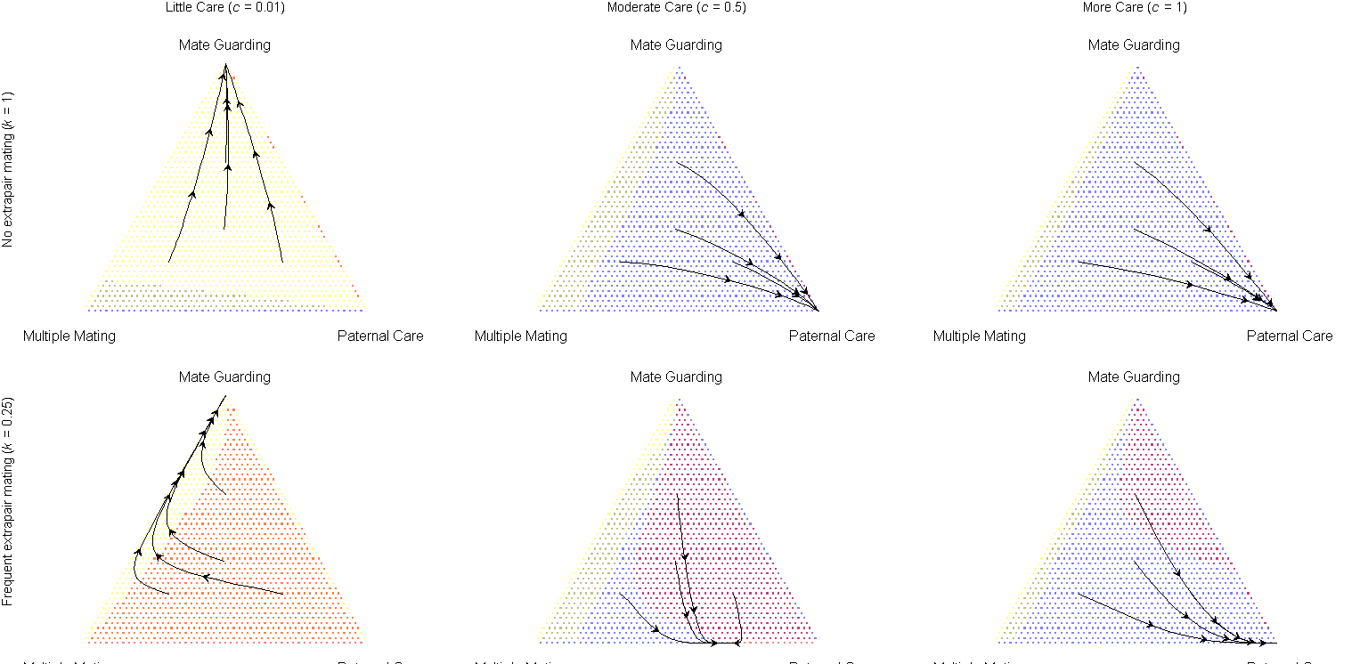
Simulation
u=0.2, k=0.25, Men’s biased(2/3)

Slide 8
Simulation
u=0.5, k=0.1, Men’s biased(5/6)

Slide 9
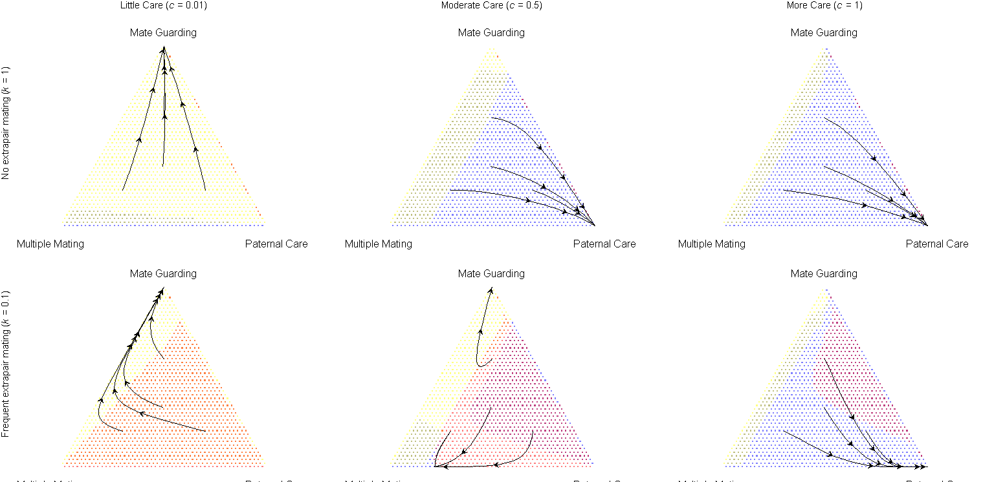
Simulation
u=0.2, k=0.1, Men’s biased(5/6)

Slide 10
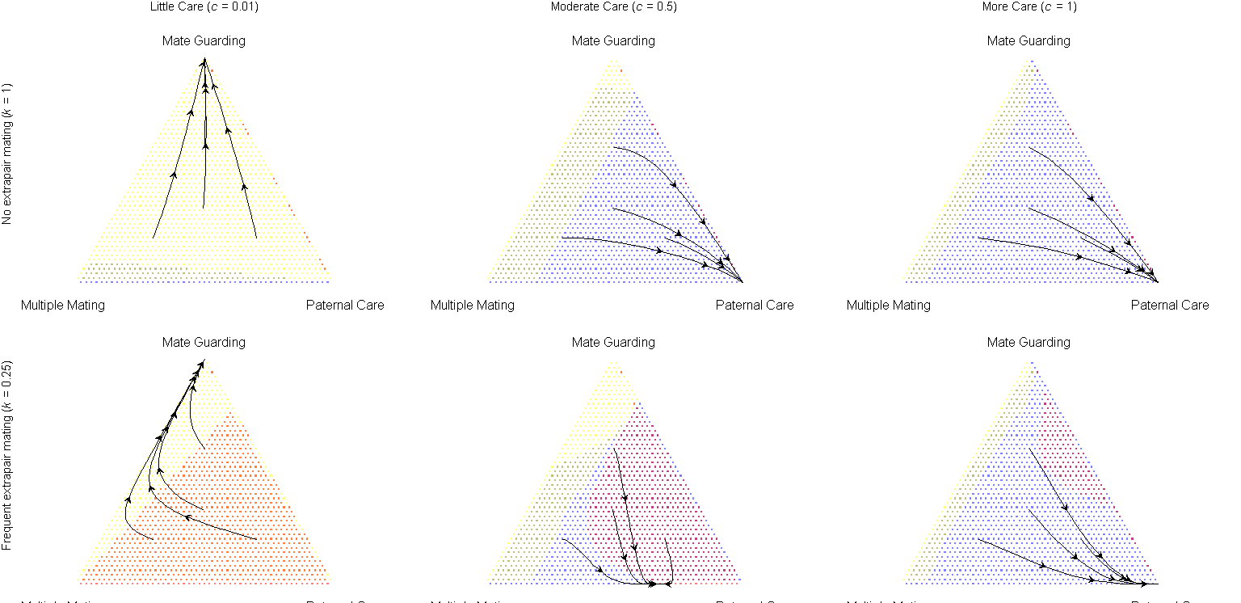
Simulation
u=0.5, k=0.25, Men’s biased(5/6)

Slide 11
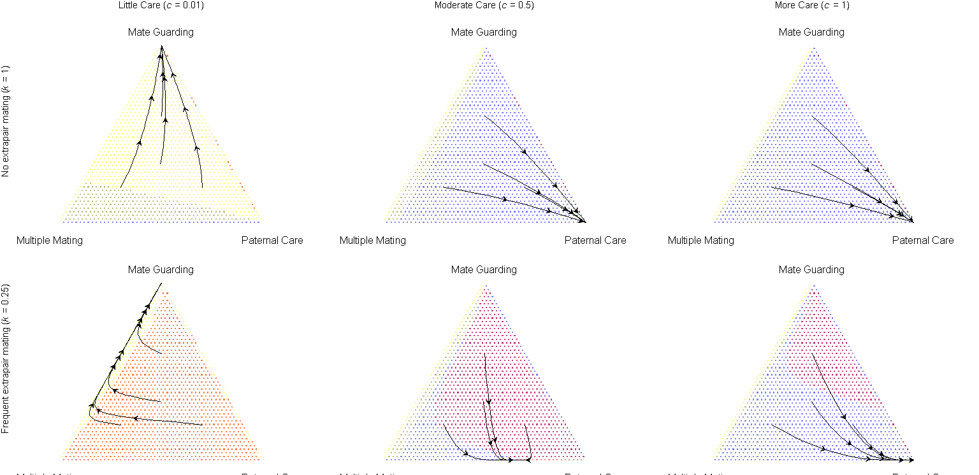
Simulation
u=0.2, k=0.25, Men’s biased(5/6)

Slide 12
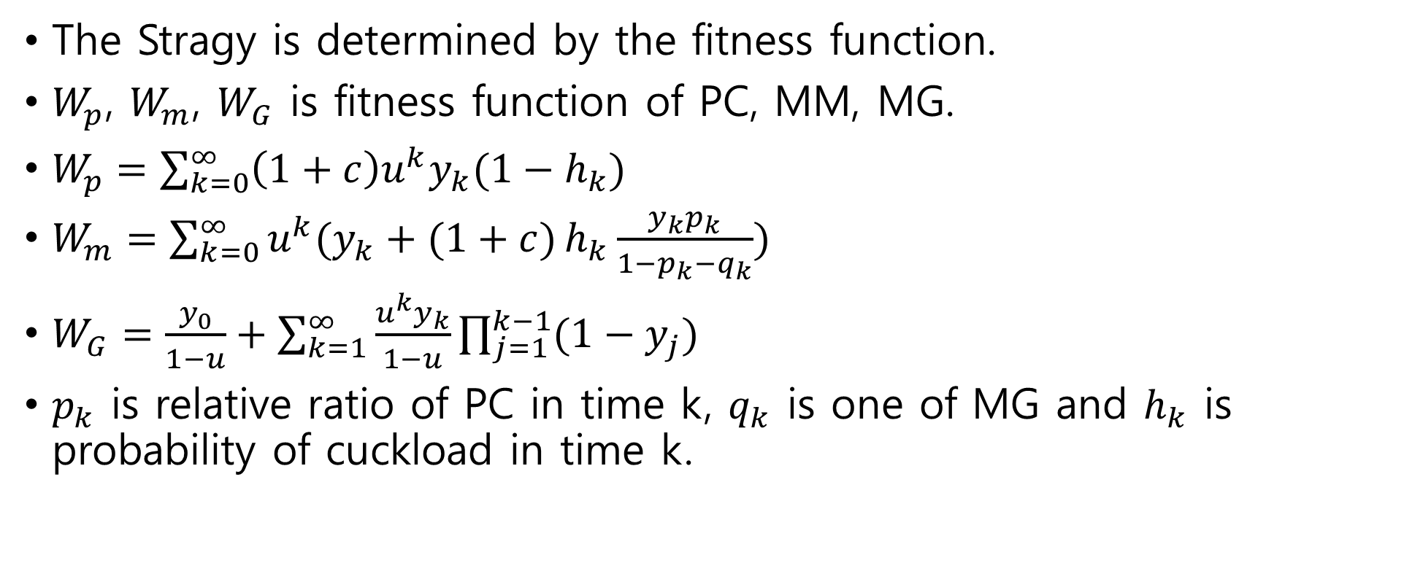
Analysis
The Stragy is determined by the fitness function.
$W_{p}$, $W_{m}$, $W_{G}$ is fitness function of PC, MM, MG.
$W_{p}=\sum_{k=0}^{∞}{\left(1+c\right)u^{k}y_{k}(1−h_{k})}$
$W_{m}=\sum_{k=0}^{∞}{u^{k}(y_{k}+(1+c)}h_{k}\frac{y_{k}p_{k}}{1−p_{k}−q_{k}})$
$W_{G}=\frac{y_{0}}{1−u}+\sum_{k=1}^{∞}{\frac{u^{k}y_{k}}{1−u}\prod_{j=1}^{k−1}{(1−y_{j})}}$
$p_{k}$ is relative ratio of PC in time k, $q_{k}$ is one of MG and $h_{k}$ is probability of cuckload in time k.
Notes:
The formula of fitness function is modified in Men’s biased simulation.

Slide 13
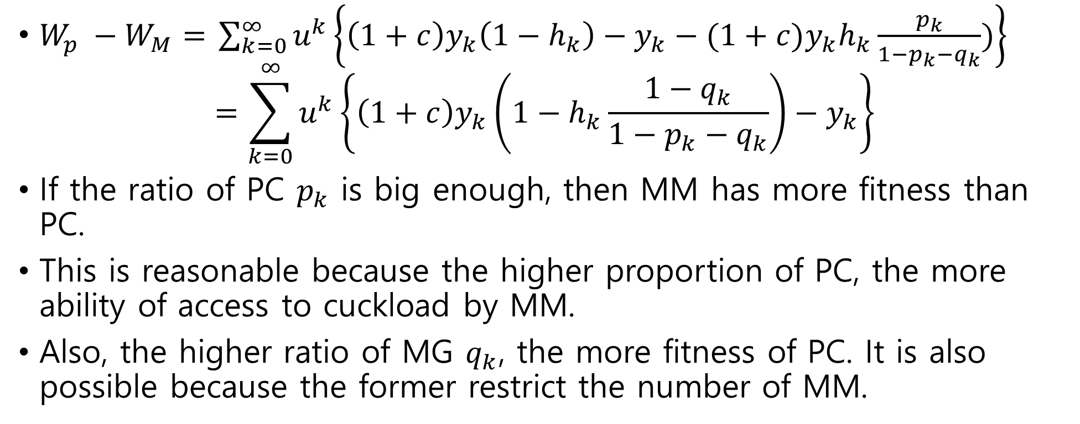
Analysis
$W_{p} −W_{M}=$ $\sum_{k=0}^{∞}{u^{k}\left\{\left(1+c\right)y_{k}\left(1−h_{k}\right)−y_{k}−(1+c)y_{k}h_{k}\frac{p_{k}}{1−p_{k}−q_{k}})\right\}}$
$$=\sum_{k=0}^{∞}{u^{k}\left\{\left(1+c\right)y_{k}\left(1−h_{k}\frac{{1−q}_{k}}{1−p_{k}−q_{k}}\right)−y_{k}\right\}}$$
If the ratio of PC $p_{k}$ is big enough, then MM has more fitness than PC.
This is reasonable because the higher proportion of PC, the more ability of access to cuckload by MM.
Also, the higher ratio of MG $q_{k}$, the more fitness of PC. It is also possible because the former restrict the number of MM.
Notes:
$$]$$

Slide 14
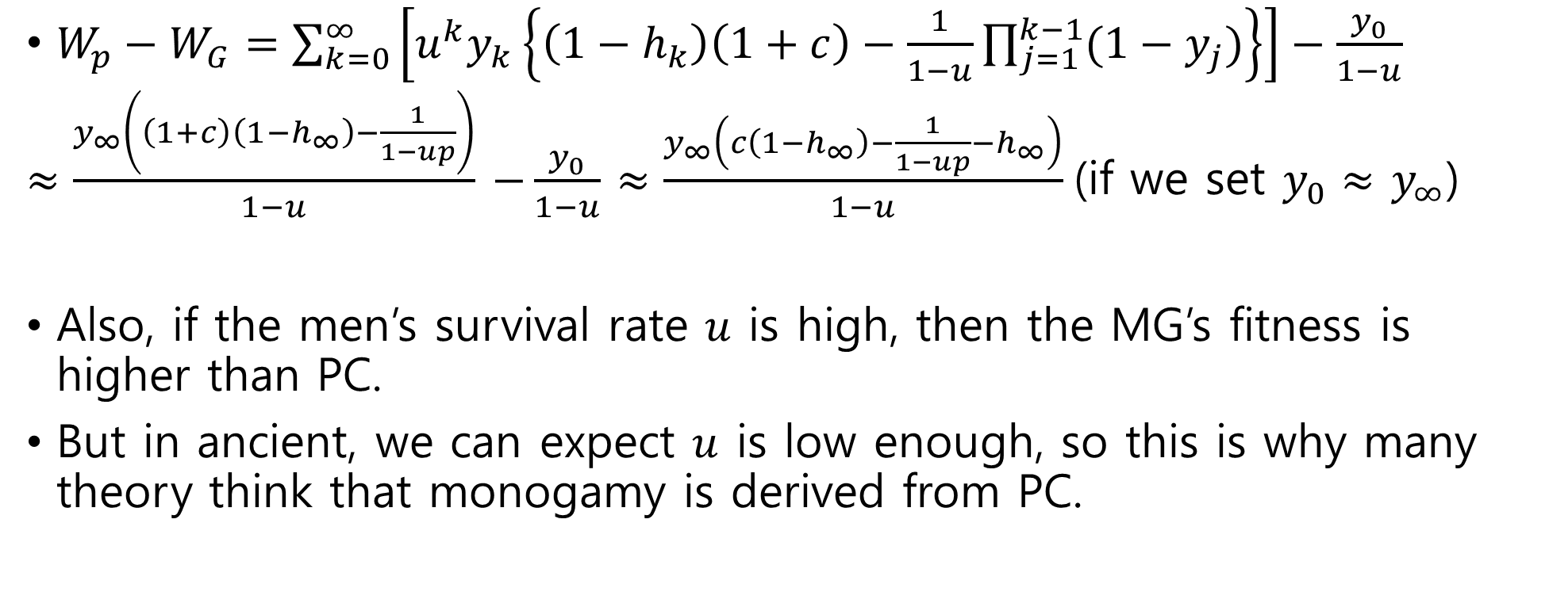
Analysis
$W_{p}−W_{G}=\sum_{k=0}^{∞}{\left[u^{k}y_{k}\left\{\left(1−h_{k}\right)\left(1+c\right)−\frac{1}{1−u}\prod_{j=1}^{k−1}{(1−y_{j})}\right\}\right]}−\frac{y_{0}}{1−u}$
$≈\frac{y_{∞}\left(\left(1+c\right)\left(1−h_{∞}\right)−\frac{1}{1−up}\right)}{1−u}$ $−\frac{y_{0}}{1−u}$ $≈\frac{y_{∞}\left(c\left(1−h_{∞}\right)−\frac{1}{1−up}−h_{∞}\right)}{1−u}$(if we set $y_{0}≈$ $y_{∞}$)
Also, if the men’s survival rate $u$ is high, then the MG’s fitness is higher than PC.
But in ancient, we can expect $u$ is low enough, so this is why many theory think that monogamy is derived from PC.
Notes:
Since $y_{k}$, $h_{k}$ is dependent on number of female and male, which are convergent due to time series. So I set $y_{∞}$ and $h_{∞}$ as convergent number.

Slide 15
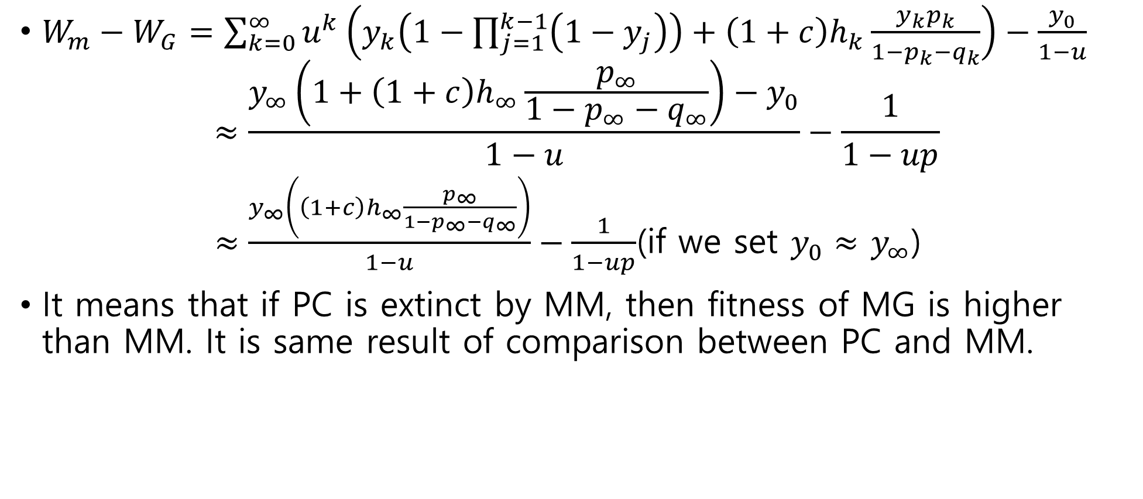
Analysis
$W_{m}−W_{G}=\sum_{k=0}^{∞}{u^{k}\left(y_{k}\left(1−\prod_{j=1}^{k−1}{\left(1−y_{j}\right)}\right)+\left(1+c\right)h_{k}\frac{y_{k}p_{k}}{1−p_{k}−q_{k}}\right)}−\frac{y_{0}}{1−u}$
$$≈\frac{y_{∞}\left(1+\left(1+c\right)h_{∞}\frac{p_{∞}}{1−p_{∞}−q_{∞}}\right)−y_{0}}{1−u}−\frac{1}{1−up}$$
$≈\frac{y_{∞}\left(\left(1+c\right)h_{∞}\frac{p_{∞}}{1−p_{∞}−q_{∞}}\right)}{1−u}−\frac{1}{1−up}$(if we set $y_{0}≈$ $y_{∞}$)
It means that if PC is extinct by MM, then fitness of MG is higher than MM. It is same result of comparison between PC and MM.

Slide 16
Conclusion
Canela people in Brazil, Acehnese people in Indonesia and Bari people in Venezuela allow Multiple Mating until 1970s, when the survival rate began to increase(EBS Docuprime, sex #003).
This means that the model in paper is well-made.
Fitness function of one stragy get effect from others, which means that there is a game between players whose stragy are different.
But the bifurcation does not need because not only complexity but also organism does not think it carefully.

Slide 17
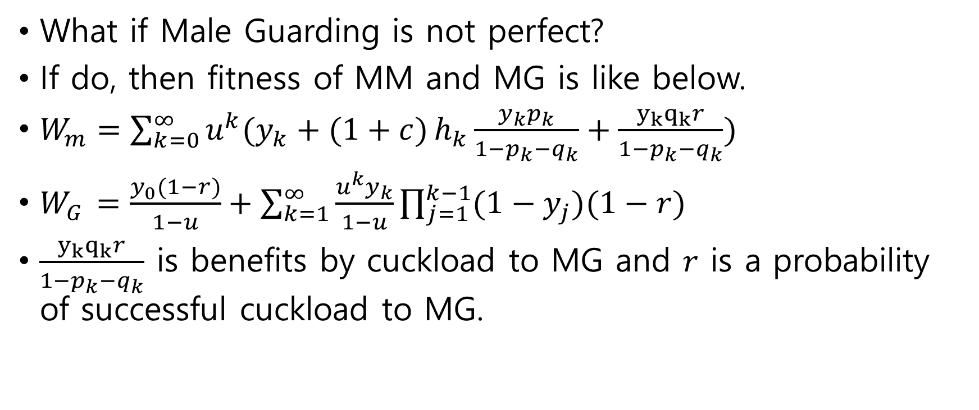
Other Possible story
What if Male Guarding is not perfect?
If do, then fitness of MM and MG is like below.
$W_{m}=\sum_{k=0}^{∞}{u^{k}(y_{k}+(1+c)}h_{k}\frac{y_{k}p_{k}}{1−p_{k}−q_{k}}+\frac{y_{k}q_{k}r}{1−p_{k}−q_{k}})$
$W_{G}$ $=\frac{y_{0}(1−r)}{1−u}+\sum_{k=1}^{∞}{\frac{u^{k}y_{k}}{1−u}\prod_{j=1}^{k−1}{(1−y_{j})(1−r)}}$
$\frac{y_{k}q_{k}r}{1−p_{k}−q_{k}}$ is benefits by cuckload to MG and $r$ is a probability of successful cuckload to MG.

Slide 18
Reference
Schacht, R., Bell, A. The evolution of monogamy in response to partner scarcity. Sci Rep 6, 32472 (2016). https://doi.org/10.1038/srep32472

